Slide 1
Bandung Traffic Jams Prediction using Random Forest
Gatum Erlangga

Slide 2
Business Understanding
Meningkatnya jumlah pengguna kendaraan bermotor.
Meningkatnya tingkat kemacetan
Mengetahui rute yang bebas dari kemacetan dapat menghemat biaya transportasi.

Slide 3
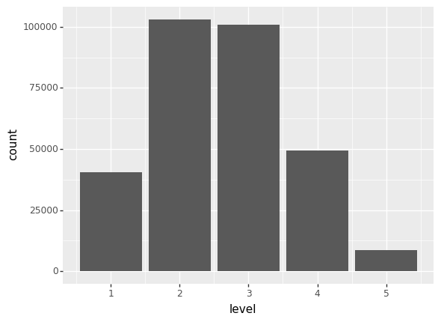
Level 5 memiliki jumlah data yang lebih sedikit dibandingkan dengan level lainnya

Slide 4
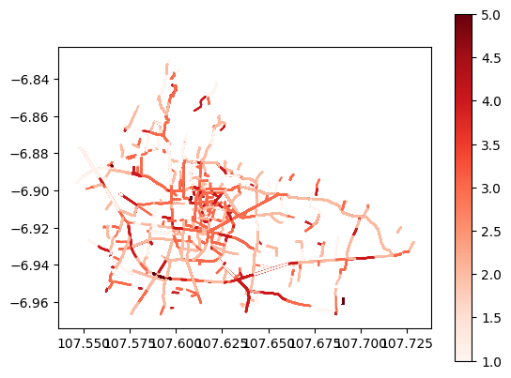
Contoh plot kemacetan (level) pada setiap jalan di kota bandung berdasarkan fitur geometry

Slide 5
Data Cleansing and Preprocessing

Slide 6
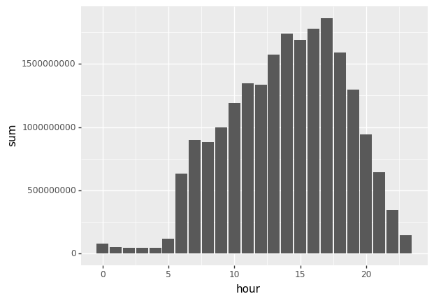
Data Cleansing and Preprocessing
Weekend dan hari libur
Time column (datetime type) to hour only
Hour Distribution based on report counts

Slide 7
Data Cleansing and Preprocessing
Peak hour and busy hour
Peak hour: hour >= 13 and <= 18
Busy hour: hour >= 6 and <= 23
Holiday total records metrics.
The sum of total records, mean, q25, q75, q50.
Weekend total records metrics.
The sum of total_records, mean, q25, q75, q50.
Street level features: Street + weekend
Feature aggregation of total_records and level with metrics q25, q50/median, q75, average, sum.
Street level features: Street + holiday
Feature aggregation of total_records and level with metrics q25, q50/median, q75, average, sum.

Slide 8
Final Data
Data columns (total 46 columns):
# Column Non-Null Count Dtype
--- ------ -------------- -----
0 time 301995 non-null object
1 kemendagri_kabupaten_kode 301995 non-null float64
2 kemendagri_kabupaten_nama 301995 non-null object
3 street 299552 non-null object
4 level 301995 non-null int64
5 median_length 301995 non-null float64
6 median_delay 301995 non-null float64
7 median_speed_kmh 301995 non-null float64
8 total_records 301995 non-null int64
9 id 301995 non-null int64
10 date 301995 non-null object
11 median_level 301995 non-null float64
12 geometry 301995 non-null object
13 thm 301995 non-null object
14 is_weekend 301995 non-null int64
15 is_holiday 301995 non-null int64
16 hour 301995 non-null int64
17 peak_hour 301995 non-null int64
18 busy_hour 301995 non-null int64
19 total_records_holiday_sum 301995 non-null int64
...
44 level_q50_y 301995 non-null float64
45 level_q75_y 301995 non-null float64

Slide 9
Modeling

Slide 10
Modeling
Cols X:
['street', 'median_length', 'median_delay', 'median_speed_kmh', 'total_records', 'median_level', 'is_weekend', 'is_holiday', 'hour', 'peak_hour', 'total_records_holiday_sum', 'total_records_holiday_q25', 'total_records_holiday_q75', 'total_records_holiday_mean', 'total_records_holiday_q50', 'total_records_busy_hour_mean', 'total_records_busy_hour_sum', 'total_records_busy_hour_q25', 'total_records_busy_hour_q50', 'total_records_busy_hour_q75', 'total_records_avg_x', 'total_records_q25_x', 'total_records_q50_x', 'total_records_q75_x', 'level_q25_x', 'level_q50_x', 'level_q75_x', 'total_records_avg_y', 'total_records_q25_y', 'total_records_q50_y', 'total_records_q75_y', 'level_q25_y', 'level_q50_y', 'level_q75_y']
Col target (y): [‘level’]

Slide 11
Modeling (2)
Library: Sklearn
Model: Random Forest
Parameter: max_depth=10, n_estimators=35, random_state=42
Steps:
Undersampling to reduce bias
Street label encoder
Train test split (test=0.33)
Model building with parameter
Model training
Evaluation

Slide 12
Model Evaluation
metrics.accuracy_score(y_pred,y_test)
0.9986052438816364
metrics.confusion_matrix(y_test, y_pred)
array([[13060, 98, 4, 0, 0],
[ 0, 33946, 0, 0, 0],
[ 0, 0, 33348, 0, 0],
[ 0, 0, 37, 16336, 0],
[ 0, 0, 0, 0, 2830]], dtype=int64)

